Slide 1
DESIGN THINKING
IDEA_CRAFTERS

Slide 2
Problem statement
Normal trolly is somewhat difficult to use:
Unable to use it on stairs.
Difficult to use in sandy road because it has small wheels.

Slide 3
materials used!

Slide 4
01.
03.
02.
04.
Iron bars
NUTS AND BOLTS
Wheels
ARC WELDING MACHINE

Slide 5
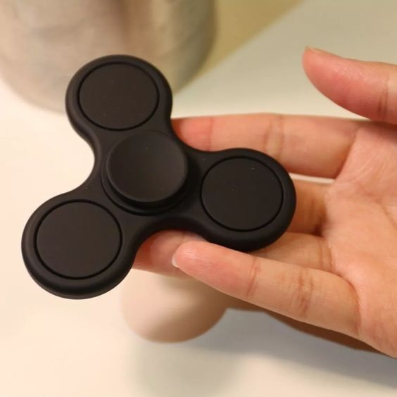
Theory behind the product
Mainly, we got this idea from fidget spinner.
A Three-wheel system on stairs typically involves a design that allows a device or vehicle to move smoothly and safely both on flat surfaces and on staircases. Here's a theoretical explanation of how such a system might work

Slide 6
Wheel configuration
01.

Slide 7
The three-wheel configuration often includes two main wheels designed for flat surfaces and a third wheel that functions as a stabilizer or an additional support when navigating stairs. The placement and orientation of these wheels are crucial for stability and maneuverability.

Slide 8
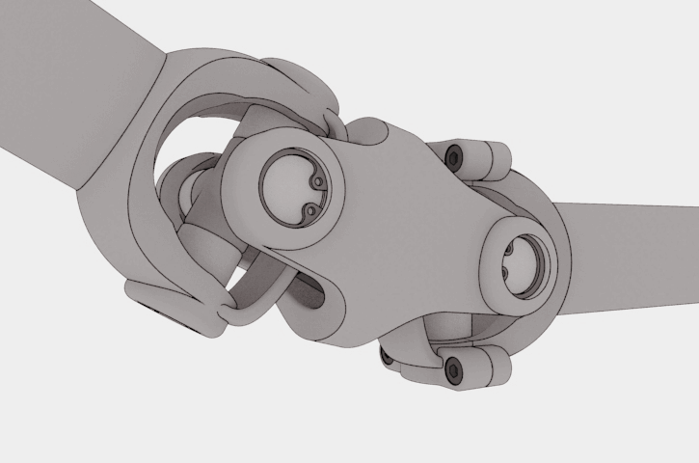
Articulation Mechanism
02.

Slide 9
The device may be equipped with an articulation mechanism that allows the wheels to adapt to the angle and irregularities of the stairs. This could involve a tilting or swiveling mechanism that enables the wheels to maintain contact with the steps.

Slide 10

stabilization Technology
03.

Slide 11
To ensure stability on stairs, the device might incorporate stabilization technology. This could include sensors, gyroscopes, or other feedback mechanisms that detect changes in orientation and adjust the position of the wheels accordingly. This helps in preventing the device from tipping or losing balance.

Slide 12
SHORT VIDEO CLIP

Slide 13
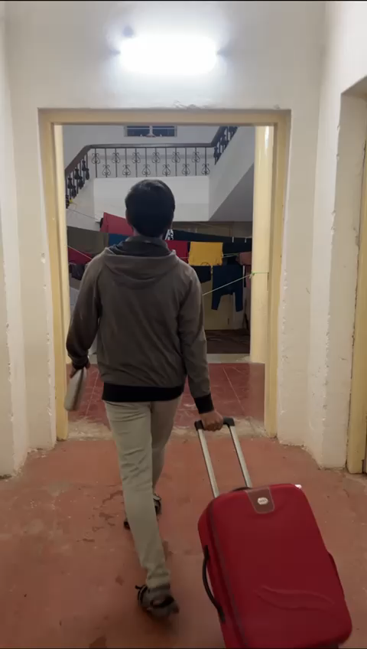

Slide 14
Project by Team IDEA_CRAFTERS:
Lokeshwar . D
Venil Venkata Reddy
Harsha Vardhan
Karthikeya Reddy
Gowtham Sai Alajangi

Slide 15

Thanks for listening

